Slide 1

DSPG 2022:Product Innovation
Stephanie Shipp, Deputy Director
Neil Alexander Kattampallil, Micah Iserman Biocomplexity Institute, University of Virginia
Gary Anderson, National Center for Science and Engineering Statistics (NCSES), National Science Foundation

Slide 2

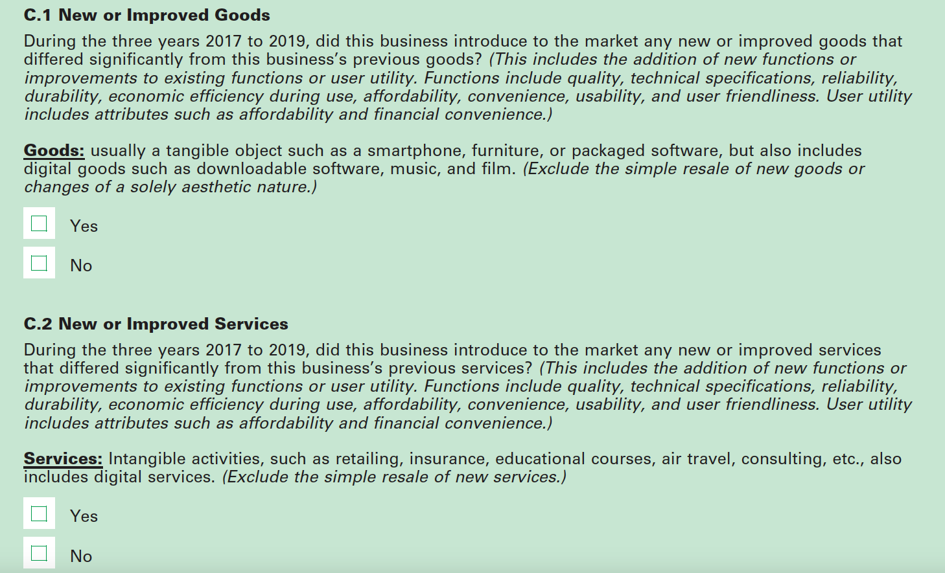
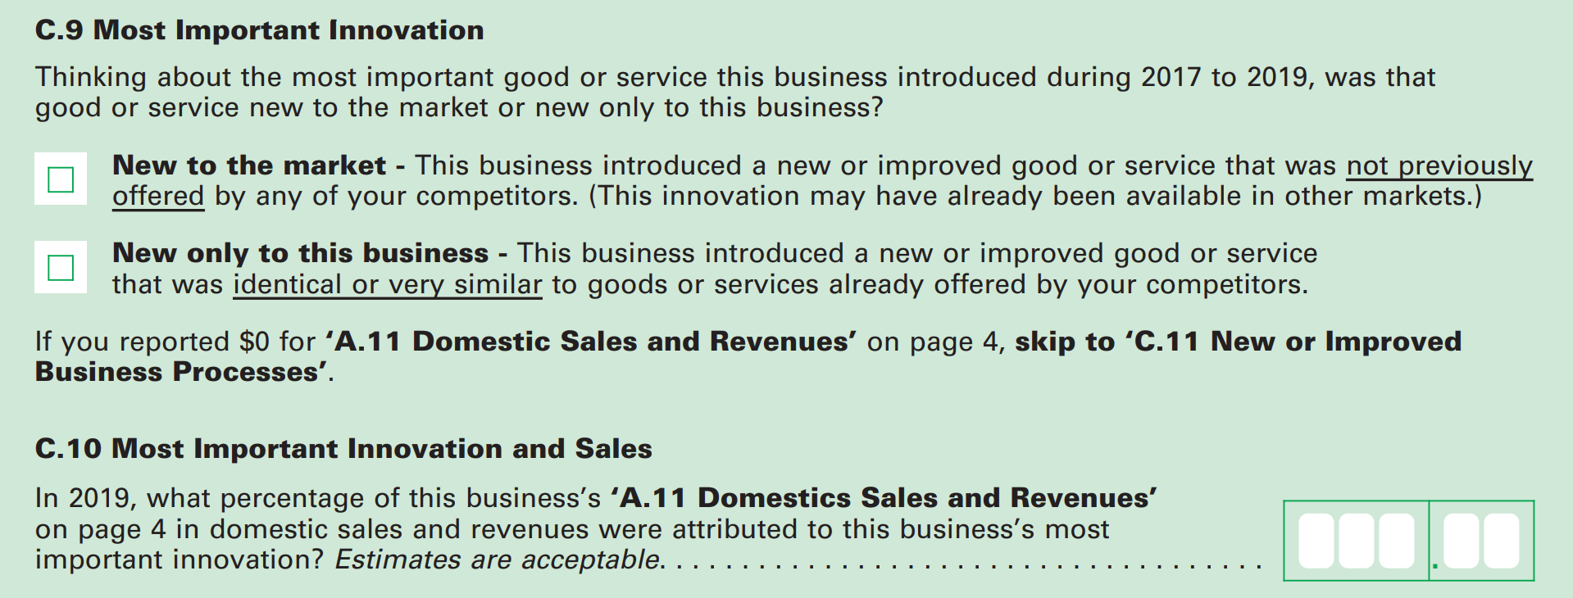
Current Measure of Innovation
EuroStat: Community Innovation Survey
Conducted every 2 years by EU member states and ESS member countries
Survey of innovation activity by enterprises
Annual Business Survey (US Census Bureau and NSF/NCSES)
Collects data on R&D, innovation, technology, intellectual property, and business owner characteristics
Annual; initial year: 2018
Previously, Business R&D Innovation Survey (BRDIS) launched in 2009
Annual Business Survey (ABS) question on innovation
Notes:
So there’s 2 standard ways that business innovation is measured and they are both surveys.
The first is EuroStat’s Community Innovation Survey, which is a survey of innovation activity by enterprises conducted every 2 years in the EU since the 1990s
The second if the Busineness R&D Innovation Survey, also known as BRDIS, which replaced the Survey of Industrial Research and Development. Launched in 2009 after a pilot in 2009
On the right, we can see how BRDIS asks about innovation [ reads question]
------ in case of questions about the survey
Other Questions:
Intent. CIS is primarily an innovation survey; BRDIS is primarily an R&D survey.
Survey context. CIS, in accordance with its intent, provides guidance on innovation and what is to be included; BRDIS provides no such guidance.
Respondent experience. CIS has been fielded many times since the 1990s, and its respondents have experience with the survey; the 2008 BRDIS pilot survey was the first time U.S.-located companies had been asked to report on their innovative activities.
Industry sectors and sizes of companies surveyed. CIS is sent to companies with 10 or more employees in industries considered to be innovative; BRDIS is a nationally representative sample of all companies with 5 or more employees in all industries.
Coverage years. Most available CIS tabulations are for the period 2004–06; BRDIS preliminary data are for the period 2006–08.
Non-response adjustments. Unit non-response is high for some countries administering the CIS, which can have a significant impact on overall rates of reported innovation; the preliminary 2008 BRDIS data were not adjusted for unit or item non-response.

Slide 3
Background and Goals
Can we use alternative (non-survey) data sources to measure business innovation?
While ABS measures innovation incidence, i.e., the number of innovating firms, we aim to test the feasibility of developing methods using non-traditional data to obtain richer and complementary innovation measures.
We develop natural language processing and machine learning methods using non-survey data to obtain richer and complementary innovation measures.
Focus on opportunity and administrative data (e.g., product announcements, press releases, financial filings).
What type(s) of innovation or improvement (i.e., greater efficacy, resource efficiency, reliability and resilience, affordability, convenience and usability) could be captured using opportunity data sources?
How does it vary across different companies and sectors?
Notes:
Is it possible to reliably identify the incidence of innovation in particular industries?
Which data sources and methods will allow us to quantify the number and types of new products being introduced? How can the new products be identified as innovative or not?
Are traditional data sources available for validation purposes, e.g., BRDIS survey? How accurate are our methods?
(Validation) Compare extracted metrics to ’ground-truth’ data, compute performance metrics
Can these data and methods be applied to other sectors?
(Repeatability) Apply to other sectors

Slide 4
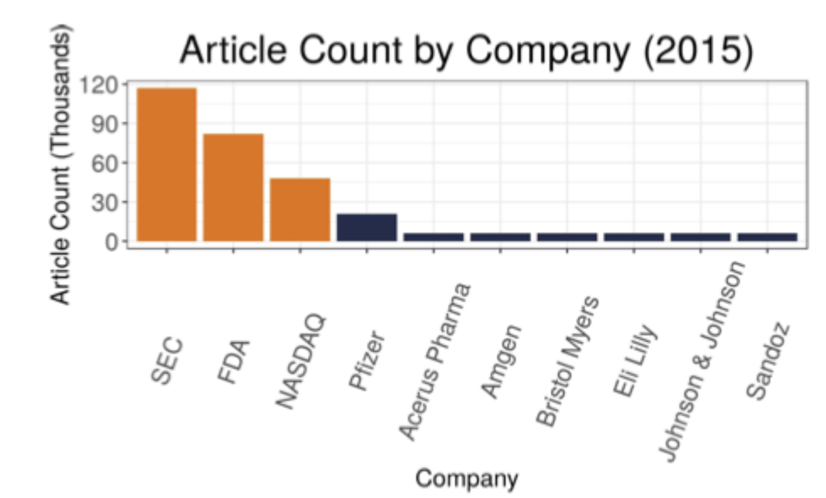


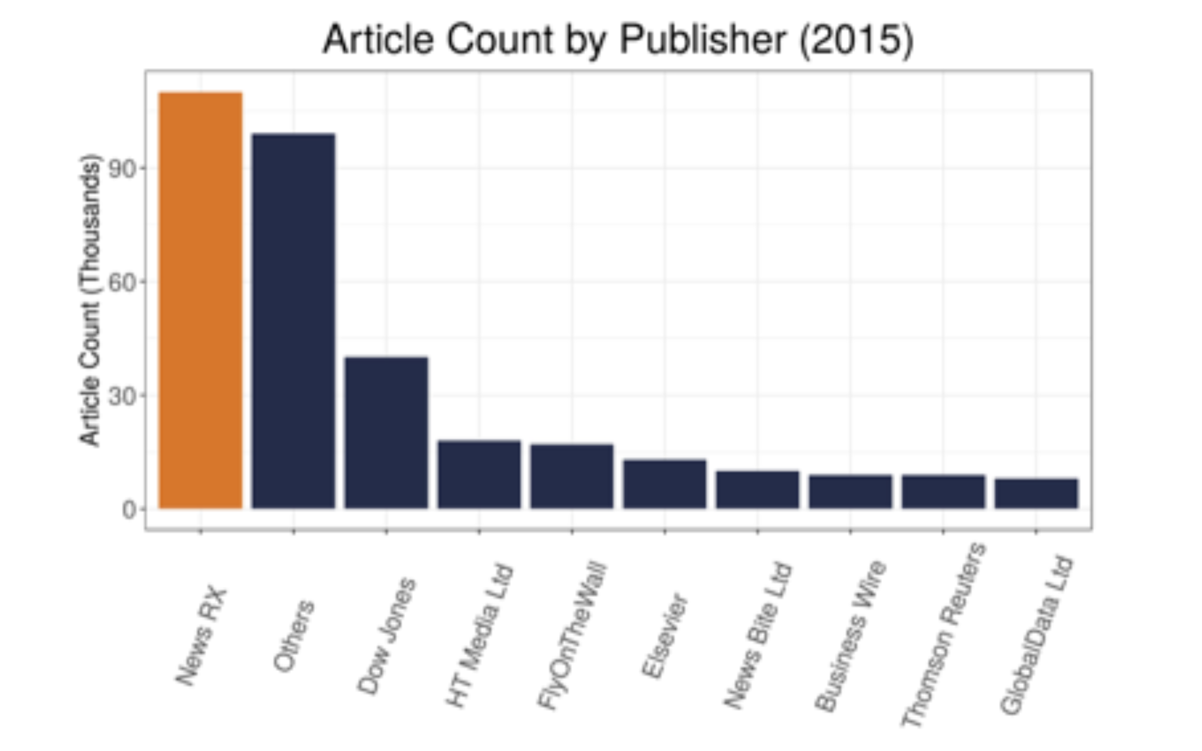
Data Sources
Pharma Articles by Company (2015)
News articles from Dow Jones Data, News, and Analytics (DNA) database
Regulatory Agencies
Companies
English language
Articles between 2013 and 2021
Region Code USA
Variables: company_codes, subject_codes, region_codes, word_count
Additional DNA Subject Codes that can be used to further improve data selection, e.g., c22 – New Product/Service
Pharma Articles by Publisher (2015)
Sector | Number of articles
Pharmaceutical and Medicine Manufacturing (NAICS 3254) | 1.8 M (2013 - 2018)
Food Processing & Beverage Manufacturing Sectors (NAICS 311 & 3121) | 600 K (2013 - 2021)
Computer Systems Design and Related Services (NAICS 5415) | 1.2 M (2013 - 2021)
Data Obtained
Notes:
company_codes refers to the companies mentioned in the article.
subject_codes refer to the subjects mentioned in the article
region_codes refers to the global zones that the article is relevant to (Europe, North America, South America, Asia, Middle East and North Africa, Africa, Australia and Oceania)
word_count refers to the length of the article
Several of these features may be interesting to explore, to see if there are correlations between likelihood of innovation and length of the article, or presence or absence of subjects mentioned in the article. These features are only available in processed commercial datasets like the DNA articles, and building a model that depends on these features would mean we would not be able to use plain-text articles from other sources, which is why we focused on using only the raw text data.

Slide 5
Challenges to tackle during the Summer
Data Acquisition is currently not the most sustainable, We’ve been able to use clean data sets from DNA to build models, but going forward we need to build open source tools to acquire news articles.
Can we use the models and data sets we currently have to inform our search for relevant news articles on the internet? Can we use information on keywords, publishers and other metadata to build better tools for Data Acquisition, that can be used by us and other research teams who would want to apply similar methods that we’ve developed?
SEC Data is another data source that we have been working with, and processing the SEC filings is a challenge since the websites that store and publish these filings have recently changed formats. Building a tool to extract and process SEC filings would give us a second clean data set to work with.

Slide 6
Proposed Schedule
Week 1: Setup of Workspace and Exploration of existing approaches
Week 2-4: Initial Sprint, building a minimum viable product
Week 5: Reflection, Identifying shortcomings and proposing solutions (Also prep for midterm presentation)
Week 6-8: Final Sprint, refinements and bug fixes
Week 9: Reports and Publishing packages, if any.
Documentation is a constant process
Use Git
Would prefer Python, as some of the BERT ML approaches don’t have R implementations yet.
Things you will learn: Webscraping, Text Data processing and Analysis, Language Models
Notes:
End of July

